Slide 1
Foundations of Entrepreneurship
Competitive Advantage
Lecture Note # 14
10.02.2021

Slide 2
Parameters determining competitive advantages.
Porter’s five forces model of competition.

Slide 3
“Of course you can still battle it out in the marketplace, but you need something that can’t be duplicated, something they could never beat you on, then hang your hat on that and don’t look back.”
Don’t despair if you don’t have an unfair advantage yet. You can build it eventually. You have to earn it.

Slide 4
Competitive Advantage
Competitive advantage is the skill necessary to outpace your rivals.
Most successful companies derive such advantages through knowledge, technology, information (data), and by adapting or restructuring their offerings as the market evolves.
Companies come up with product-market-fit and customers love the product/service they offer.
Create great brand with such narrative that customers fall in love with their story and the brand.

Slide 5
Drivers of Competitive Advantages of Business Model
01
Attractive market structure
06
Easy product extension
02
Growth potential
07
Core competency
03
Entry barrier
08
Logistic advantage
04
Scalability
09
Great brand - loyal followers
05
Repeatability
10
Pricing power
11
New experience/ meaning

Slide 6
Entry barrier
Technological edge
Intangible assets
Economies of Scale and cost advantage thereof
Geographical Barriers
Access to strategic resources
Product differentiation
Capital requirements to enter a market
Customers' cost of switching
Access to distribution channels
Government policy and
The degree of firm concentration
Brand loyalty, core competency
Customers' cost of switching,
Technological edge
Intangible assets
Economies of Scale and cost advantage thereof
Geographical Barriers
Access to strategic resources
Product differentiation
Capital requirements to enter a market
Access to distribution channels,
Government policy and
The degree of firm concentration

Slide 7
Entry barrier
Technological edge
Intangible assets
Economies of Scale and cost advantage thereof
Geographical Barriers
Access to strategic resources
Product differentiation
Capital requirements to enter a market
Customers' cost of switching
Access to distribution channels
Government policy
The degree of firm concentration
Brand loyalty, core competency
Technological edge
Intangible assets
Economies of Scale and cost advantage thereof
Geographical Barriers
Access to strategic resources
Product differentiation
Capital requirements to enter a market
Customers' cost of switching,
Access to distribution channels,
Government policy and
The degree of firm concentration

Slide 8

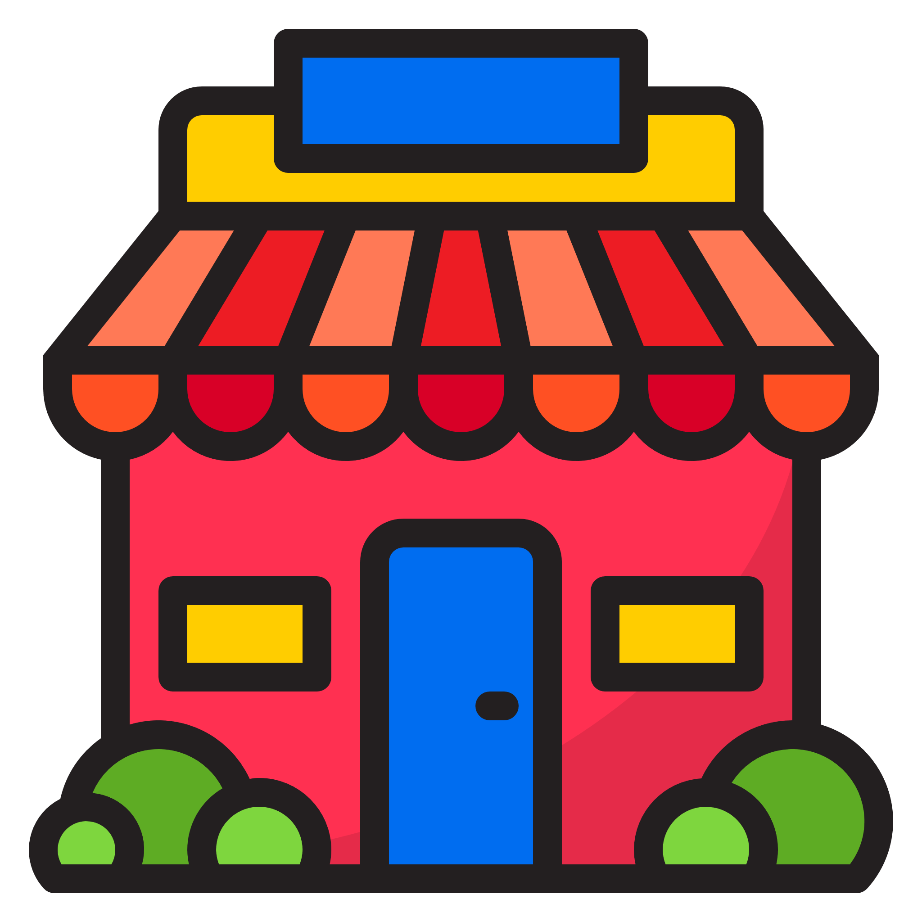

Entry Barrier for You to Enter into a Market /Industry

Slide 9


Entry Barrier for Others to Enter into the Market You Serve

Slide 10
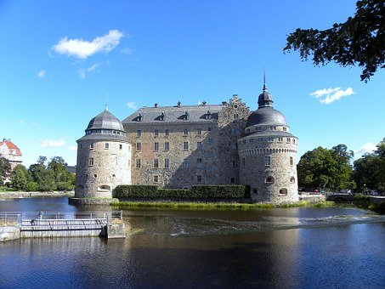
Entry barrier – Moat

Slide 11


Entry barrier – Moat

Slide 12

Entry barrier – Moat

Slide 13
Scalability
Scalability – how easily business can scale or grow. Software application is a classical example of scalable solution. Developing it is costly but can be cloned at very little marginal cost.
Many of the E-commerce businesses are easily scalable.
Good examples are Amazon, Flipkart, Practo
In network based companies, scalability is a must for sustainability.

Slide 14
Pricing power
Pricing power is the capacity to increase price without affecting the level of customers’ demand for the product.
Say you are the sole manufacturer of a life-saving drug. You can increase the price without much impact on the sales volume. Monopoly, brand loyalty, trust, superior value proposition give pricing power.
The ability to raise prices is one of the most important characteristics that determines sustainability and profitability of a business.
Whenever input costs go up, firms can pass it over to customer by increasing price without the fear of losing customers.

Slide 15
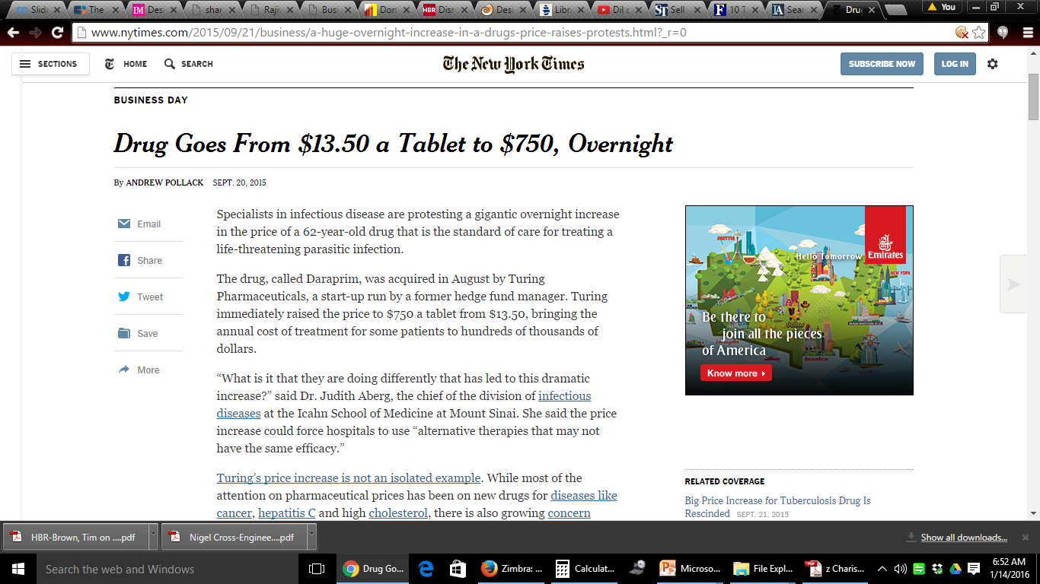

Example of Monopoly, Pricing Power, and Extreme Greed/ Notoriety
Martin Shkreli
toxoplasmosis
Notes:
Pyrimethamine

Slide 16
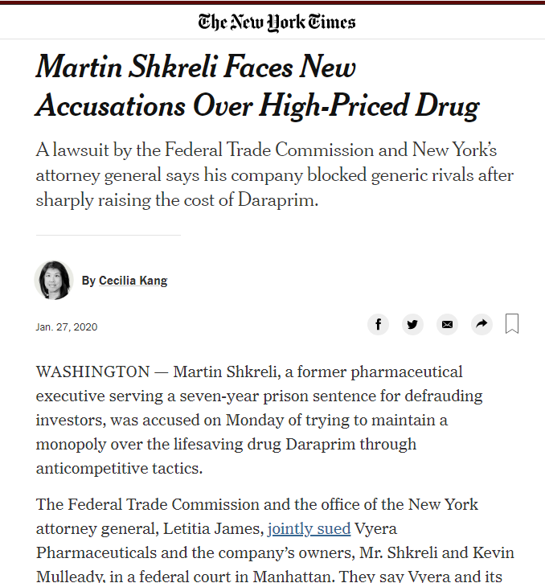


Slide 17
Sustainability of Pricing Power
July 27, 2016 :
Imprimis Pharmaceuticals waiting FDA approval for $1 copycat of Daraprim.
The same drug is already being made by many generic drug companies in
India, where it can cost as little as 4 cents.
Australian high school students developed process to make the drug at a cost of $1 1$ a tablet.

Slide 18
One has to always pay huge price for notoriety.

Slide 19
Market Structure
Market structure provides a holistic view of the competitive landscape of the industry and market attractiveness of a new businesses.
The present market-growth
Likely growth in the future
The number of firms
The market share of the largest firms
Market size
The nature of costs
The degree to which the industry is integrated
The extent of product differentiation
The customer turnover
Notes:
Customer attrition, also known as customer churn, customer turnover, or customer defection

Slide 20
Market Types
Most common types of markets | Number of companies | Product type | Barrier for new entrant | Pricing power
Monopolistic | Ideally single company | Simple | High | High
Oligopolistic | Small number of companies | Differentiated | High | High. Usually collude themselves.
Perfect Competition | Many | Homogenous | Nonexistent | Absent

Slide 21
Drucker's Five Deadly Sins in Business
Seeking high profit margins and premium pricing
One should seek an optimum profit margin and high sales that will maximize profits.
Charging what the market will bear
Analogy Xerox & Nylon of DuPont
Using cost-driven pricing
Try price-driven costing instead
Focusing on past winners
"slaughtering tomorrow’s opportunity on the altar of yesterday"
Giving problems priority over opportunities
Notes:
Example Xerox’s fax machine

Slide 22
Repeatability
Cost of acquiring a customer is huge. This cost includes cost of product, research, marketing, and accessibility.
Firms incur such huge cost on customer acquisition with the understanding that the customers would make repeated transactions and the life time value would give considerable profit to the firm.
Therefore, the business model should ensure that customers come repeatedly.

Slide 23
Easy product extension
Creating awareness among customers requires valuable resources.
Create impression among your target market segment through one product.
Introduce new products targeting the same segment as a natural extension at low marketing cost.

Slide 24
Core Competency
A core competency is a concept in management theory propounded by C. K. Prahlad and Gary Hamel.
"A core competency is an area of specialized expertise that is the result of harmonizing complex streams of technology and work activity." ~ C. K. Prahalad
In other words, it is unique capability or efficiency gained through harmonized combination of multiple resources and skills giving a company unique competitive advantage.
This advantage of the company is invisible and thus cannot be copied.
It greatly and sustainably contributes to stakeholders’ value.

Slide 25
Logistic Advantage
Nearness to inputs.
Closeness to markets.
Availability of knowledge workers or cheap labor.
Access to ready and efficient distribution network.
Ready or presence of ecosystem.

Slide 26


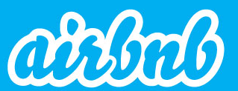
Strong Brand Presence / Brand Loyalty
Brand Storytelling can be a powerful and effective way to make emotional connection with customers & build lasting relations.
Use the story to engage consumers and elicit emotion to foster loyalty, forging a meaningful relationship that goes far beyond product and service.
Loyal customers will be ready to pay higher price for your product than that of similar competing products.
Thus you gain huge competitive advantage and sustain above average profit.
The Bélo
Belonging

Slide 27
More Strategies to Gain Competitive Advantages
Cost leadership strategy – you may place yourselves ahead of the pack by offering attractive price. But must avoid a low-quality image.
Product differentiation and positioning strategy - Nike
Operational effectiveness – do what you do best or at least better than others.
Adaptability competitive advantage – adapt to change in this age of unpredictability and rapid change.
The information advantage – All other strategies can benefit from data and analysis to translate into information.

Slide 28
Product Differentiation
Quality (low, average, high, best)
Features
Forms
Shapes
Style
Packaging
Size
Price
Variety
Composition
Availability
Durability
Reliability
Maintainability
Ease of installation
Ease of purchase
Return policy
Repurchase
Exchange offer
Loyalty program

Slide 29
Porter’s Five Forces Competition Model
Michael E. Porter of Harvard Business School placed the competitive landscape or the micro environment of any industry in the form of five forces.
The five forces that determine the competitive intensity and therefore attractiveness of a market.

Slide 30
Porter’s Five Forces Competition Model
Bargaining power of SUPPLIERS
Threat of NEW ENTRANT
Threat of
SUBSTITUTES
Competitive rivalry within an industry
Bargaining power of BUYERS

Slide 31
Porter’s Five Forces Competition Model
Threat of new entrants
Bargaining power of suppliers
Price sensitivity
Availability of substitute
Cost of changing
Uniqueness of product
Competitive rivalry
Market structure
Quality difference
Switching costs
Customer loyalty
Competitive rivalry within an industry
Bargaining power of suppliers
Bargaining power of Buyers
Threat of substitute
Substitute quality
Cost of change
Threat of new entrant
Entry barrier
Economies of scale
Specialist knowledge
First mover advantage
Brand loyalty
Bargaining power of buyers
Price sensitivity
Availability of substitute
Cost advantage
Cost of changing
Threat of Substitutes

Slide 32
Porter’s Five Forces: The Horizontal Forces
Competitive Rivalry – strengths and weaknesses of your competitors vis-à-vis your advantages. Intense rivalry may lead to aggressive price cut and more power to suppliers and buyers. Moderate competitive rivalry may lead to healthy profit.
Threat of New Entrants – If you are making good profit, others will start doing the same business. If there is barriers for new entrant, you may maintain your advantages.
Threat of Substitution – there may not be many sellers of the product that you sell. But if buyers can manage with a substitute product and that is available at attractive terms, they may switch to that putting pressure on you to reduce price.

Slide 33
Porter’s Five Forces: The Vertical Forces
Supplier Power – how dependent is the suppliers on your business and vice versa. If you have many suppliers, you may command terms of supply and control price. Else, you are in a sellers’ market (sellers can dictate terms).
Buyer Power – are there many buyers? Does it cost them much to switch to new sellers? If they can dictate terms you may have to price vary competitively? Else you may make healthy profit.

Slide 34
Life span of companies are shrinking, so is the life span of products and services.
It may not bode well to target sustainable competitive advantage on a past winning product since the product itself may not sustain.
Those who are nimble enough to constantly build or refine products and meet the changing needs and taste of the customers are likely to create great companies.

Slide 35
Business Model & Business Model Innovation (BMI)
“A business model describes the rationale of how an organization creates, delivers, and captures value, in economic, social, cultural or other contexts. The process of business model construction and modification is also called business model innovation and forms a part of business strategy.” - Wikipedia

Slide 36
Business Model
Business model is core aspect as to how a business creates and profitably delivers value to a group of satisfying customers.
It is imperative that a business creates social, environmental, and cultural values for sustainability in the long run.
Business model includes the purpose, vision, target customers, offerings, the value proposition, organizational structures, business process, infrastructure requirement, values and culture.

Slide 37
Innovation
Innovation is the process of turning new ideas and knowledge into value, in the form of new products, services, or ways of doing things.
It is deceptively complex, and goes beyond mere creativity and invention to include the steps necessary for benefiting people.
Very few innovations are groundbreaking. Majority are value addition to on earlier versions.
Evidently, innovative firms significantly outperform others.
Innovations fuel the majority of the world's long-term productivity and economic growth.

Slide 38
Necessity Is the Mother of All Innovations
If you are wondering which direction new technologies will emerge,
Perhaps the best place to look at is the severest of pains the society is facing or likely to face in the immediate future.
Pipping into research laboratories may not be much help.
Go out and do something. You may encounter problems and start building solutions to that.
Many entrepreneurs built solutions to problems they faced themselves. Phanindra Sama of redBus, Mahendra Pratap of Integra Micro Systems and many more.

Slide 39
Business Model Innovation (BMI)
A business model is a business context explaining how an organization creates and delivers values in economic, social, cultural or other forms.
The process of reconstruction of various aspects of the business for meeting changing market behaviour and delivering increasingly superior value to customers is business model innovation.
Execution of the plan is an integral part of BMI and thus, management is inextricable part of BMI. Management innovation is a continuous process.

Slide 40
When the game gets tough, change the game.
Example: Dhirubhai

Slide 41
Innovation Contexts
Innovation
Technology innovation
Business Model Innovation
Government innovation
Innovation systems
Innovation for social benefits
Source https://intelligence.weforum.org

Slide 42
Technology Innovation – Emerging Areas
Fourth industrial revolution
Biotechnology
3D printing
Virtual and augmented reality
Artificial Intelligence & Robotics
Human enhancement
Advanced materials
5G
Internet of things
Autonomous transportation
Digital communication
Blockchain
Quantum computing

Slide 43
Business Model Innovation: Industrial Revolution - 4.0
Disrupts status quo to provide better comforts to people or alleviate pain.
The future of economic progress
Shape corporate governance
Next generation information technology
Will promote new multinationals

Slide 44
Is Technology Innovation Different from BMI?
All technology innovations are part of BMI
Some BMIs are through technology innovation

Slide 45
“Get the business model wrong and there is no business” – Prof. David Teece, University of California, Burckley
The What, Why, How, and Whom of BMI
⬥
⬥
⬥
⬥
What – What innovations are you executing?
Why to innovate business model – will it create more value to your customers and bring advantages to your organization?
How – how are you going to create and deliver economic, social, cultural and environmental values?
For whom – Whose problems are you aiming alleviate?
Add to this, the when of BMI?

Slide 46
Business Model Innovators Outperform Competition in Terms of Operating Margin, Shareholders’ Return

Slide 47
Business Model Innovation is Possible in Several Forms
Value Proposition | The product as service and outcome General Electric SaaS | The products as an experience Apple – iPod Candle with aroma | Trust premium Whole Foods TATA | Free (or nearly free)/ Freemium Google Gaana Spotify
Operating Model | Deconstruction Li & Fung Ltd. Adani | Integration/ acceleration of the supply chain Zara Reliance | Low cost Aravind Tata Motors | Direct distribution Google CCD Nestle Nespresso
Business System Architecture | Open Apple Facebook | Person to person PayPal PayTM | Adjacency Ikea’s Mega Mall Division | Serial Virgin Group
Recreated from BCG Research
Notes:
Today’s consumers are always connected, time starved and experience driven – while demanding greater transparency and sustainability. – at Li& Fung

Slide 48
Management Innovation
General Electric.
DuPont.
Procter & Gamble.
Visa.
Linux.
What makes them stand out?
Great products? Yes.
Great people? Sure.
Great leaders? Usually.
But if you dig deeper, you will find that the fundamental reason for their success: management innovation.

Slide 49
Management Innovation Example of Focused R&D
In the early 1900s, General Electric of Thomas Edison disciplined the chaotic process of scientific discovery into a systematic process of innovation.
Results: over the next 70 years, won more patents than any other company in the US.
Much of GE’s competitive prowess during the century following it can be traced to that extraordinary accomplishment.

Slide 50
Management Innovation Example: Accounting & Finance - DuPont
In 1903, DuPont systematized capital-budgeting techniques. A few years later, the company also developed a standardized way of estimating return on investment.
They used it in comparing the performance of its numerous product departments.
These innovations and more helped DuPont become one of America’s industrial giants.

Slide 51
BMI Example: Brand management - Procter & Gamble
Procter & Gamble pioneered to formalize brand management since 1930s.
In the decades since, P&G has steadily built brands with loyal customer followings.
Brand and other intangible assets have been driving the success of the company ever since.
Today, P&G owns some 16 brands that have been producing more than $1 billion in sales every year.
P&G is pioneer in ‘Corporate Entrepreneurship’, and is an aggressive promoter (and beneficiary) of ‘Open Innovation’.

Slide 52
Business Management Innovation Virtual office - Visa Inc.
Visa’s success is attributed to organizational innovation.
Visa is almost a virtual company and their main asset is their brand (intellectual property) with global visibility.
Starting in the 1970s, Visa has created a global network that links more than 21,000 financial institutions and 1.3 billion+ cardholders.

Slide 53
Open source: Linux
Linux – the open source computer operating system.
Linux is the initiative that extended the concept of other innovations like the general public license and online collaboration tools.
Open source development has proven to be a highly effective mechanism for engaging people without geographical or cultural boundary.

Slide 54
Aggregator Uber
Uber could really define the pain points and applied latest technologies to solve it. In urban places of high mobility -
It is very difficult to get a taxi.
One that would come and pick you up
One with some identity for reliability and safety
To know when a taxi will arrive.
Ease of paying for the tip.
They innovated the solution based on the pains.

Slide 55
Netflix
Netflix has specialized in online on-demand video streaming.
Starting in 1999, the company now has over 117 million subscribers in 190 countries.
The company constantly innovates to give new experience to customers.
In 2018, Netflix innovated ‘choose-your-own-adventure’ programming, that presents a vision for interactive television.

Slide 56
iPod
A single invention of iPod has affected many markets at once
– the music industry,
hardware vendors,
the labor market,
artists and
consumers themselves.
In a quest to make music more portable and on-demand designers, engineers and marketers at Apple got together to create the iPod and achieved huge success.

Slide 57
They all expand the market. There are customers and there are producers. But there always is a gap that separates the two and brings in huge inefficiencies.
Entrepreneurs come up with new business model to bridge the gap that multiplies the demand and supply.
Netflix, Uber, all aggregators, etc.

Slide 58
Innovation Lessons from Steve Jobs: The story of iPod
Explore the customer experience and work backwards to technology.
Know the competitors’ value proposition and offer superior value.
Recruit a balanced and excellent team.
Connect the dots.
Obtain feedback and simplify constantly.

Slide 59
“You can’t connect the dots looking forward; you can only connect them looking backwards. So you have to trust that the dots will somehow connect in your future. You have to trust in something – your gut, destiny, life, karma, whatever. This approach has never let me down and it has made all the difference in my life.” – Steve Jobs

Slide 60
Hindustan Unilever: BMI
Fast moving consumer goods (FMCG) companies were focused mainly to the urban markets.
In the face of steep competition, Hindustan Unilever in 2004, shifted the focus to rural India.
Smaller sachets of personal care products were made available.
Distribution and warehousing were redesigned.
New products were launched.

Slide 61
ZIPDIAL (zipdial)
Business Model Innovation in India
The business model
Customer wants to know about a product
Customer gives a missed call using mobile phone to a given number
The mobile user is now subscribed with the customer service section
The desired information is immediately sent to the inbox
Customer relation is established without spending a single paisa

Slide 62
Novelty
No unsolicited push message.
Only the interested gives a missed call to get information about some offer.
No cost on the part of the company and the customer (missed call does not cost).
One of the cheapest process of building customer awareness and relationship.
Times of India’s initiative Against Corruption campaign received 4.6 million unique missed call.
Its clients include Coca-Cola, Disney, P&G, Dove and many more.
Founded in 2010, Twitter acquired zipdial for about US $ 50 million in 2014.
Facebook uses the same idea in its Click-to-Missed-Call Ad that helps advertisers in customer acquisition.

Slide 63
Goonj: A non-government organization (NGO)
Goonj collects used cloths in donation
Distributes them among the poor in exchange of some work.
Founder: Anshu Gupta
Revenue: $ 9.2 M (old data: 2011-12)
Employees: 75
Goonj has partnered with Puma to promote circular economy.
Facebook for its Click-to-Missed-Call Ad product that helps advertisers in customer acquisition.
Notes:
For every contribution made in-store or online, they will be gratified with PUMA gift vouchers.

Slide 64
Interview Street
Key People: Vivek Ravishankar, Harishnkaran K
It has been started by two alumni of NIT Trichy, a premier institution in India.
They conduct real programming tests to help companies to screen candidates using their web-based tools.
If you can write brilliant codes, you will be hired, no matter what your qualification is.
They provide services to companies such as Amazon, Facebook, Morgan Stanley and Walmart.

Slide 65
Mitra Biotech
Key people: Mallikarjun Sundaram
Boston and Bengaluru
Mitra Biotech develops and provides novel technologies that personalize cancer treatment.
Founded by a group of researchers from Harvard and MIT, Mitra Biotech tries to lessen the risk of chemotherapy.
They have developed a technology CANScript to create an artificial tumor of the patient outside the patient’s body.

Slide 66
Some Recent Disruption for BMI
Thomas Cook, Cox & Kings. Company blamed surge of online booking for its failure.
Kodak – started in 1841 and failed in 2019.
Borders (were selling books in physical stores)

Slide 67
Detail
design
Recreated from
https://en.wikipedia.org/wiki/Business_model
Piloting
Experim
enting
Prototyping
Implementation
Concept design
Detail design
Launch
Reflection
Ideation
1
Business model innovation is a dynamic, iterative, and continuous process that seemingly moves in circle
Concept
design
8
2
7
3
6
4
5

Slide 68
Why Do Companies Engage in BMI

Slide 69
Ref. Karakaya, Fahri. (2002) Barriers to entry in industrial markets. Journal of Business & Industrial Marketing. 17(5), 379-388.
Sarasvathy, S. D. (2001). Causation and effectuation: Toward a theoretical shift from economic inevitability to entrepreneurial contingency. Academy of management Review, 26(2), 243-263.
Soota A. and S. R. Gopalan (2016) Entrepreneurship Simplified – From Idea to IPO, Penguin Portfolio.
Entrepreneur's Handbook: Everything You Need to Launch and Grow Your New Business - Harvard Business Review (2018).
https://garfinkleexecutivecoaching.com/ 7 Strategies to Define your Competitive Advantage by Joel Garfinkle

Slide 70
Reference: Hamel, G. (2006). The why, what, and how of management innovation. Harvard business review, 84(2), 72.
https://intelligence.weforum.org/topics/a1Gb0000000LrSOEA0?tab=publications
Teece D. J. (2018) Business models and dynamic capabilities, Long Range Planning, 51(1), 40-49
https://medium.com/swlh/why-90-of-startups-fail-and-what-to-do-about-it-b0af17b65059
https://www.cbinsights.com/research/startup-failure-lessons/
What is BPM Anyway? Business Process Management Explained (http://www.bpminstitute.org/resources/articles/what-bpm-anyway-business-process-management-explained).
Teece D. J. (2010) Business Models, Business Strategy and Innovation, Long Range Planning, 43, 173-194
https://medium.com/swlh/why-90-of-startups-fail-and-what-to-do-about-it-b0af17b65059
https://www.slideshare.net/sniukas/this-is-business-model-innovation
https://businessmodelgallery.com/models/amazon-retail/

Slide 71
Thank you

